Slide 1


Red hat openshift deployment AI/ML documentation

Slide 2
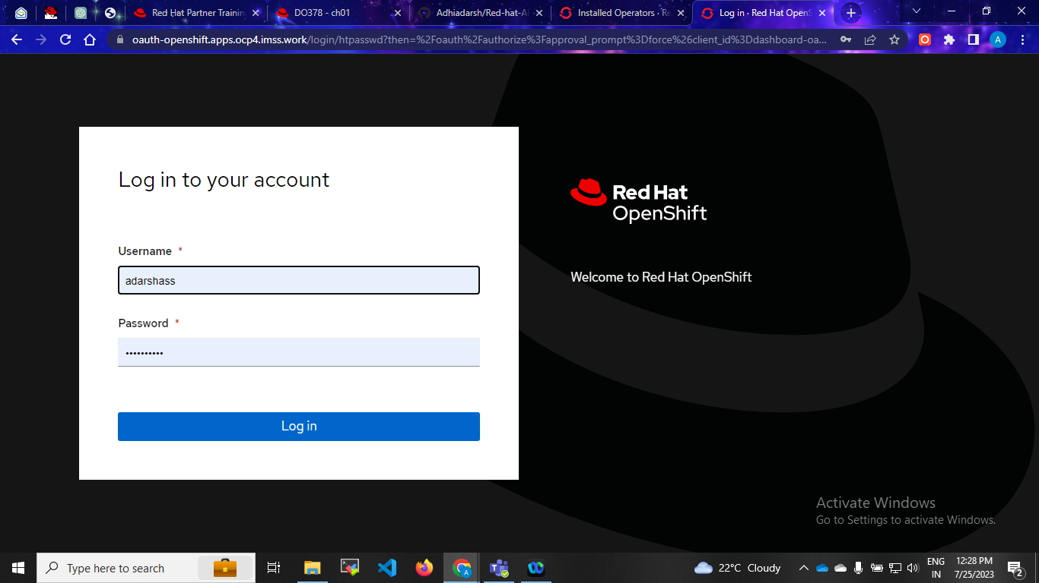
Step:1 Cluster login

Slide 3
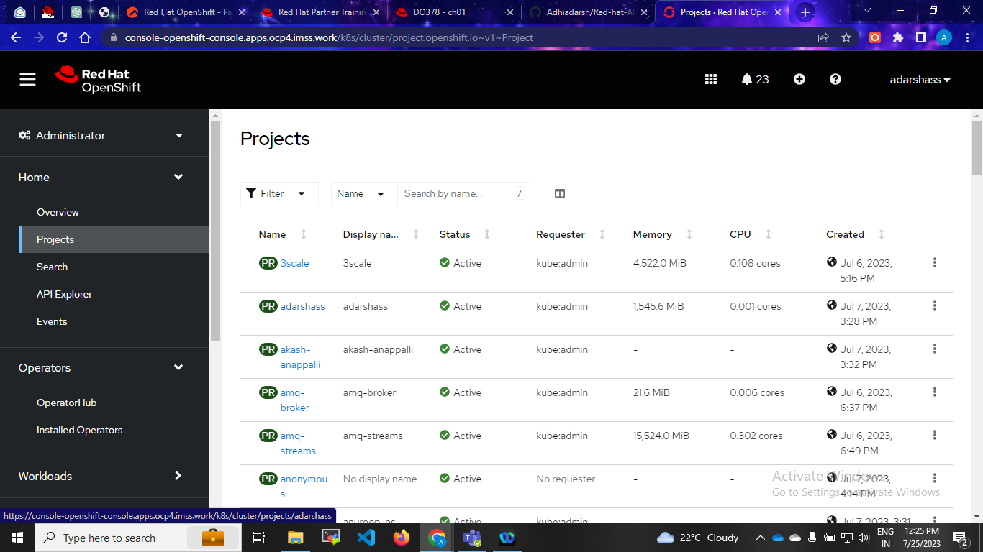
Step:2 Create your project name

Slide 4
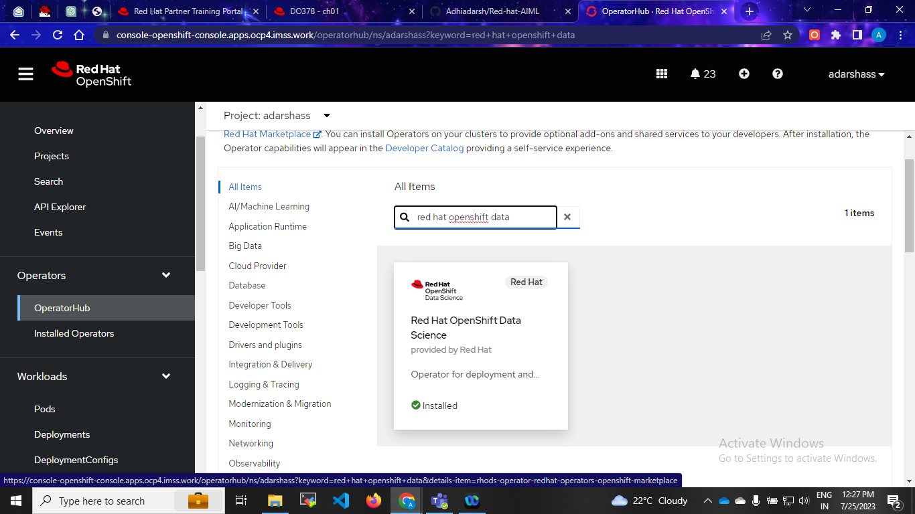
Step:3 Install red hat openshift data science operator

Slide 5
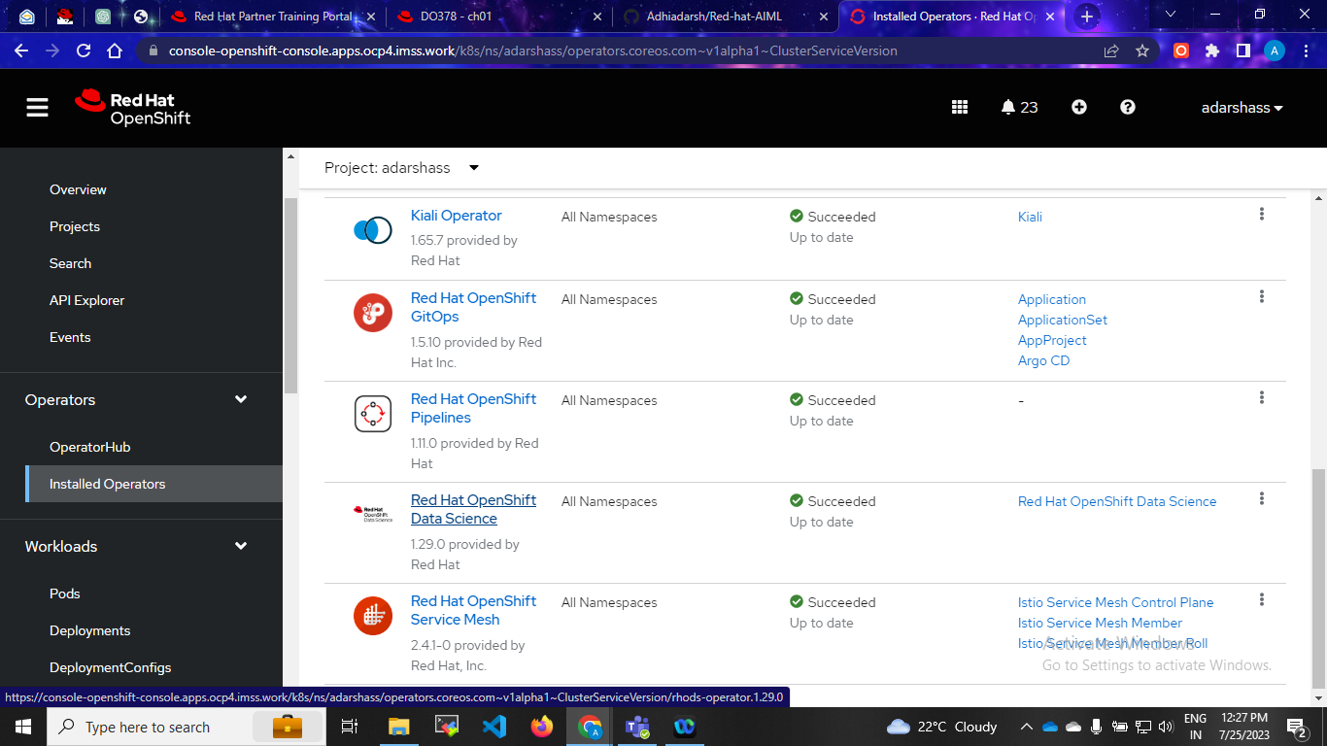
Check installation

Slide 6
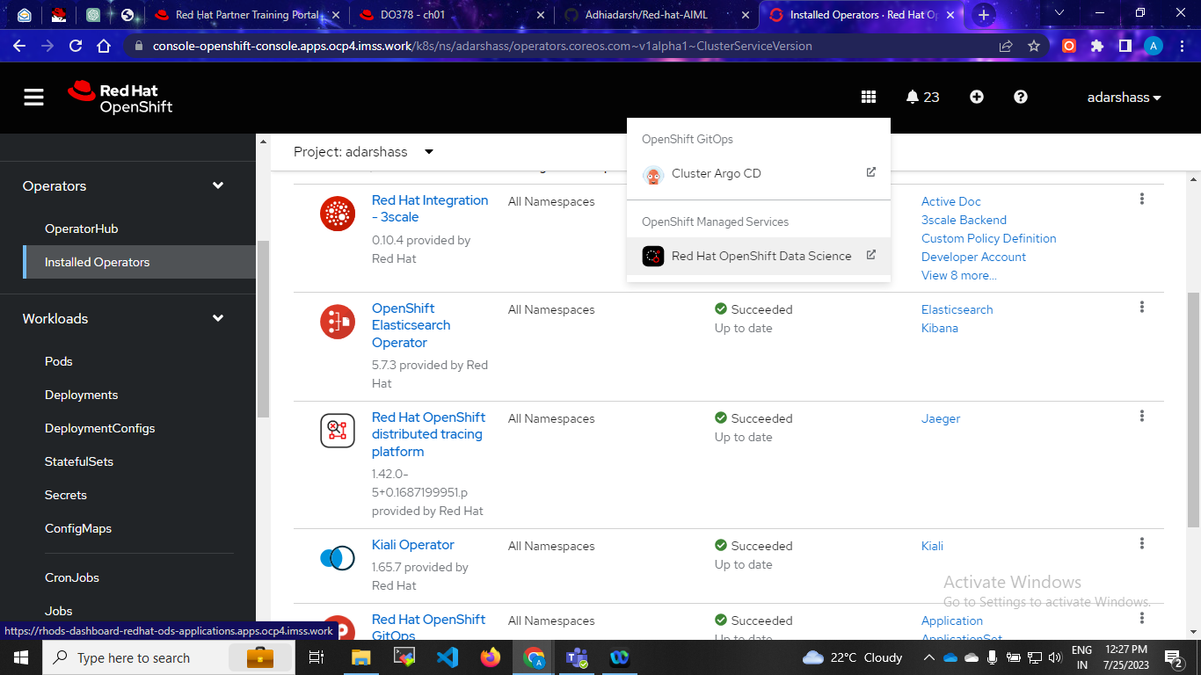
Step:After installation open

Slide 7
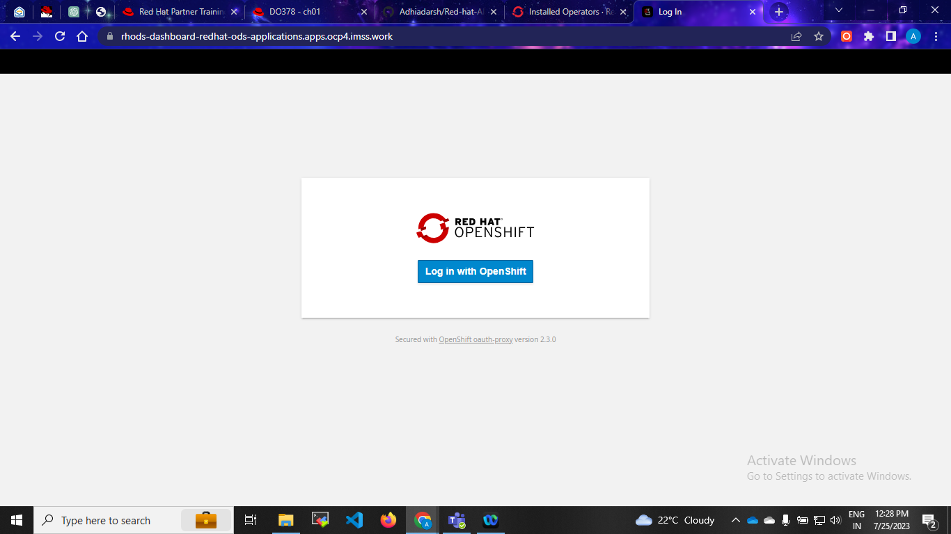
Step:5 Login with same username and password

Slide 8
Login with same credentials

Slide 9
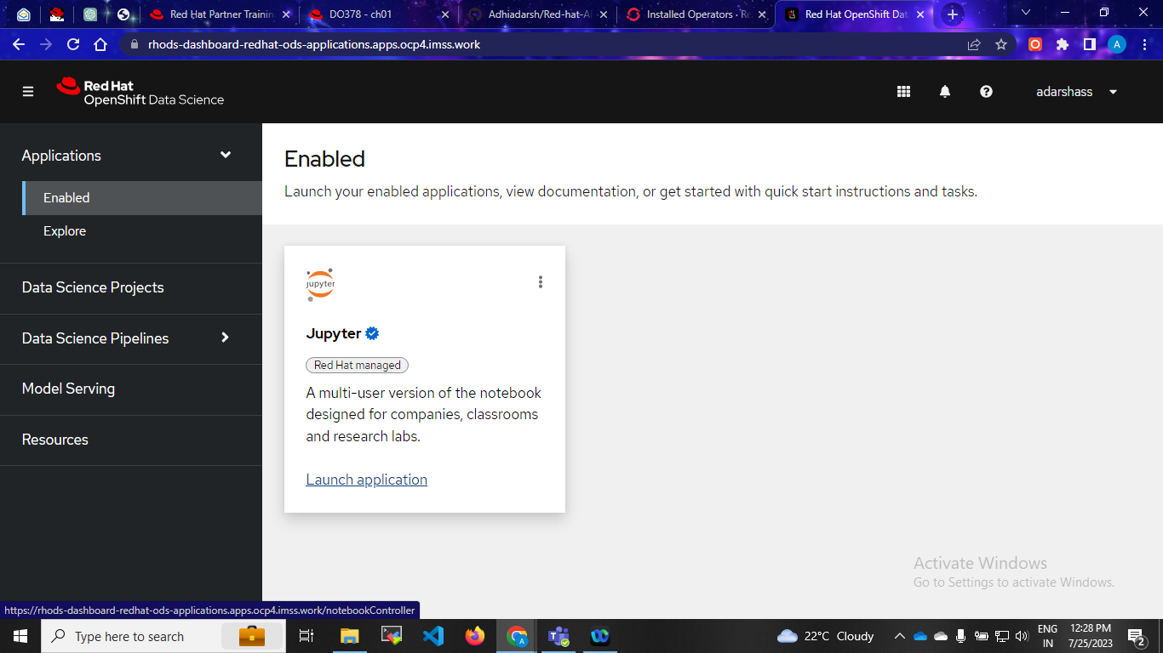
Step:6 Lunch jupyter

Slide 10
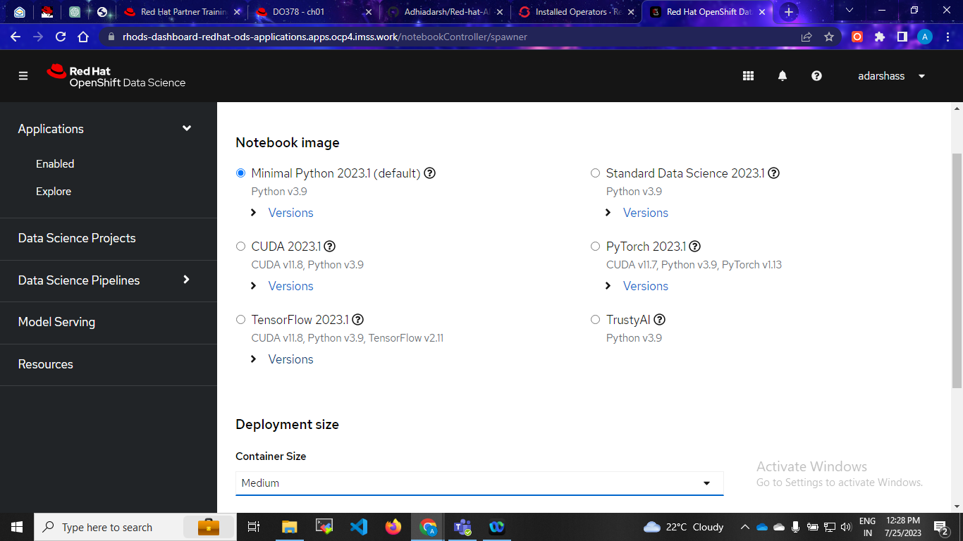
Follow the steps

Slide 11
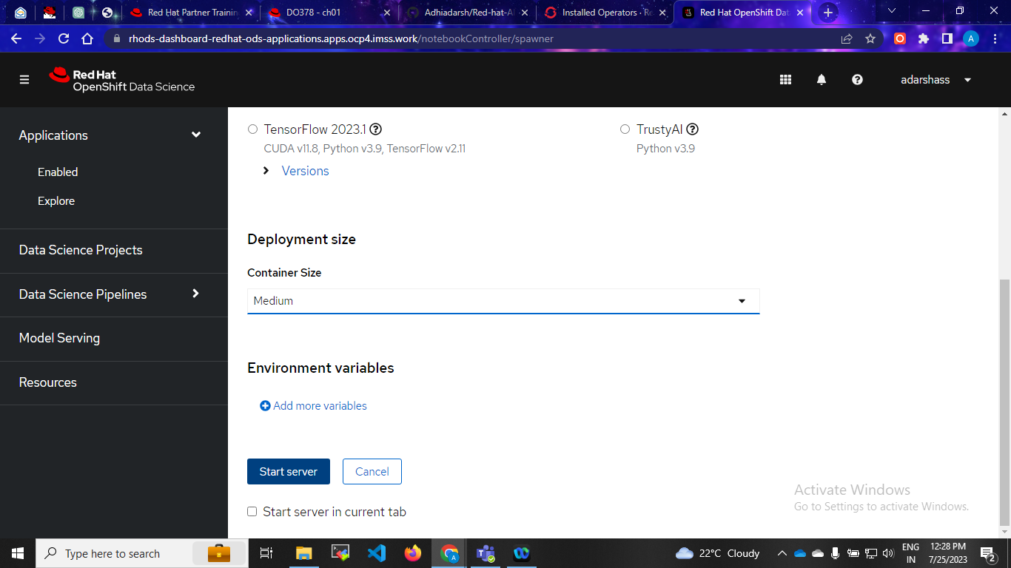
Click start

Slide 12
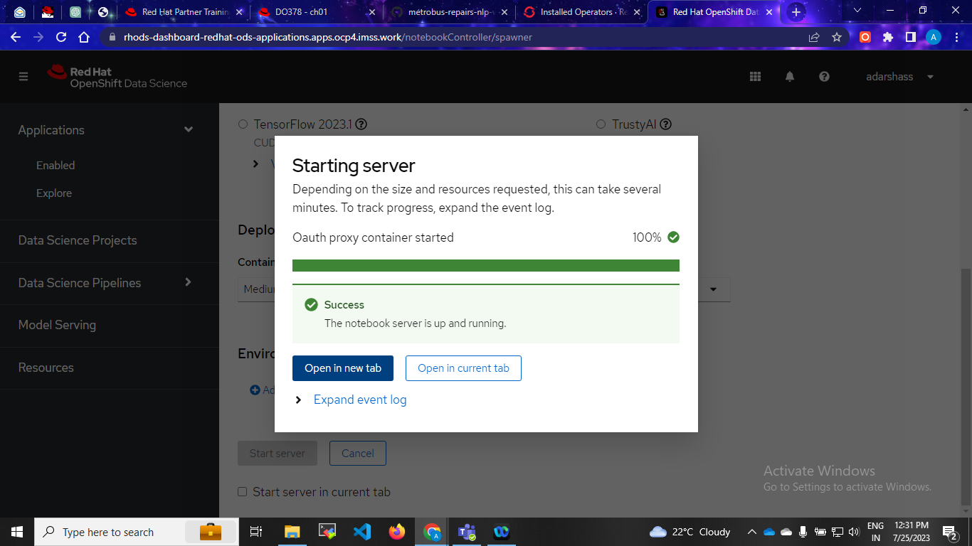
Steps:6 After launch jupyter open tab

Slide 13

Login

Slide 14
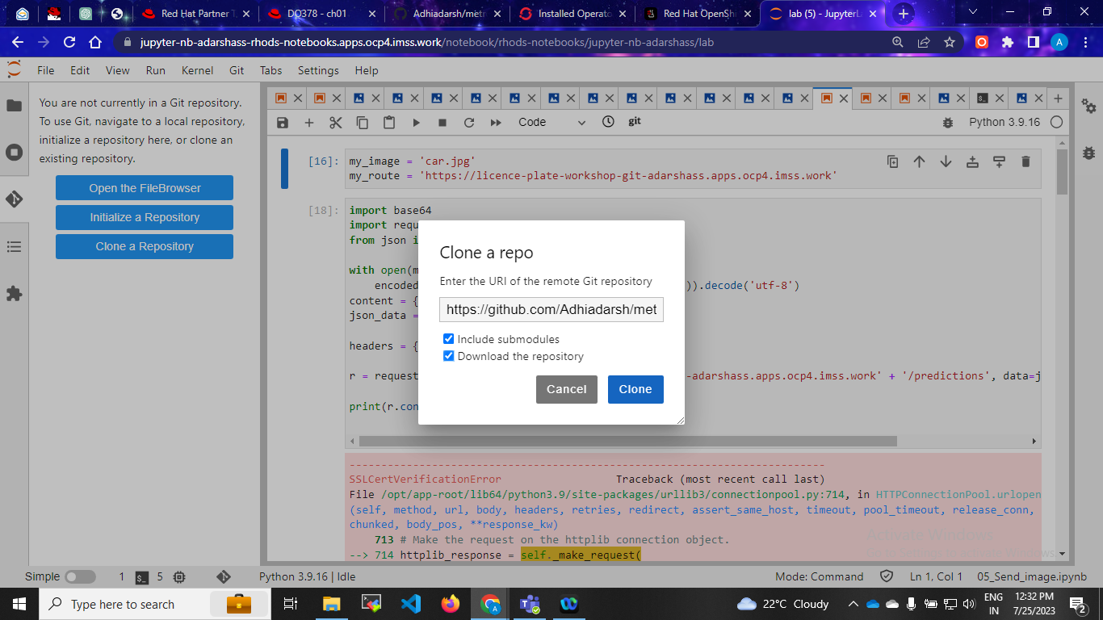
Git url and clone

Slide 15
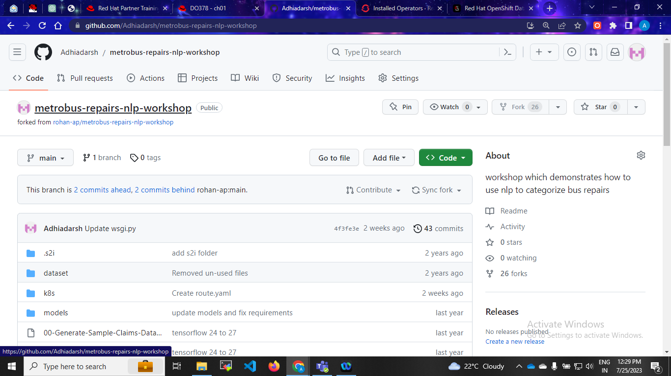
Git hub url

Slide 16
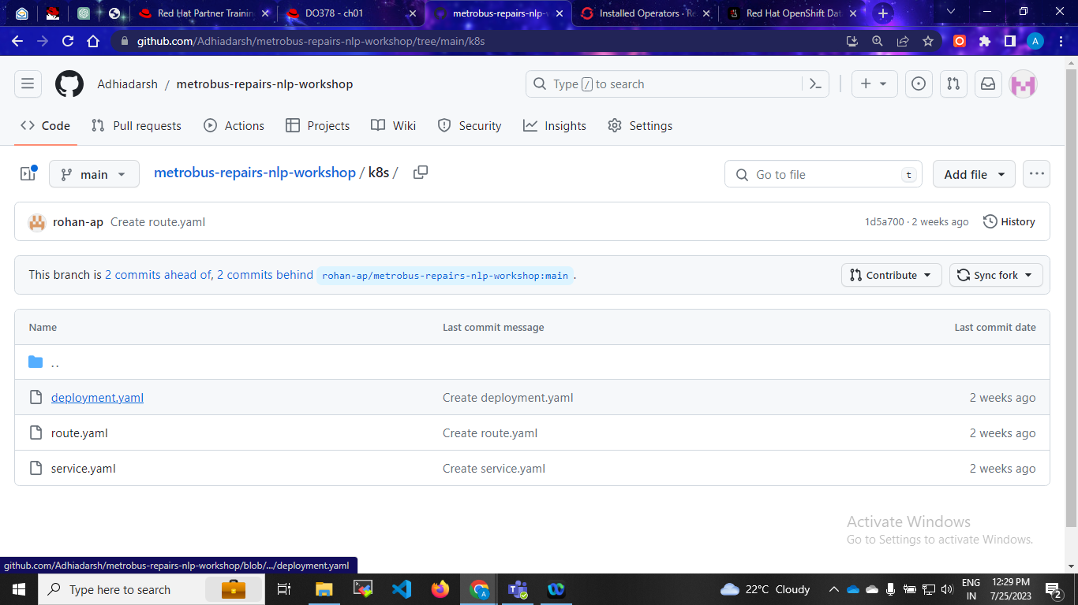
Project Git Hub url

Slide 17
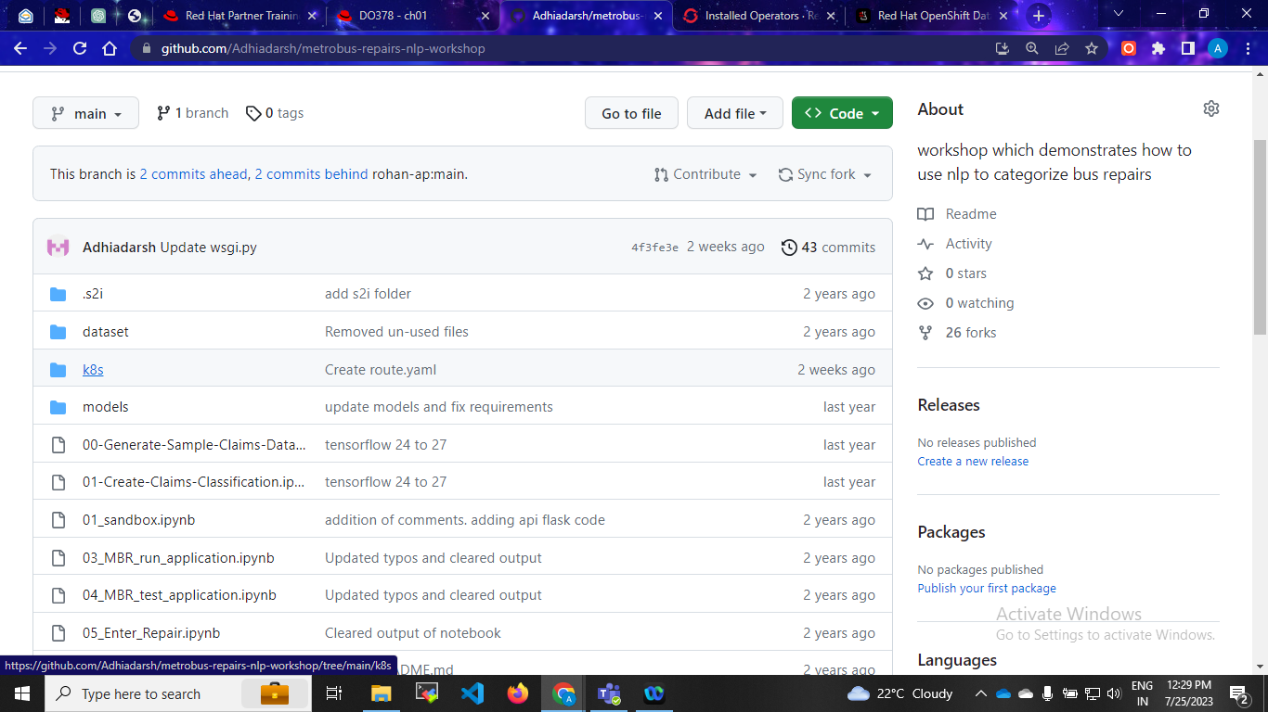
Steps: Open K8s file

Slide 18
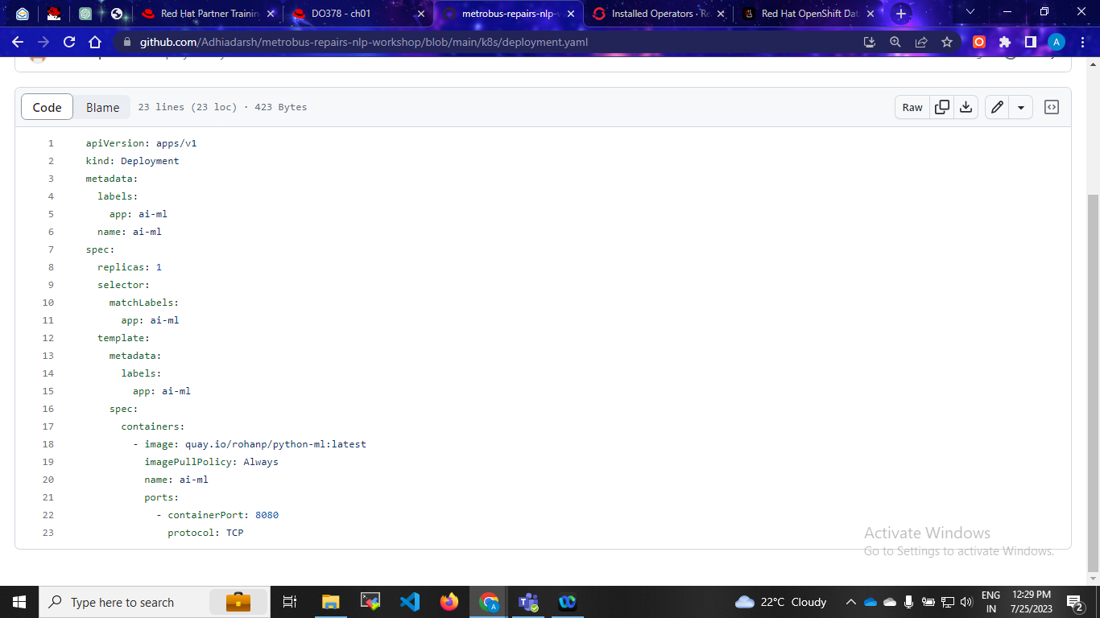
Quay image

Slide 19
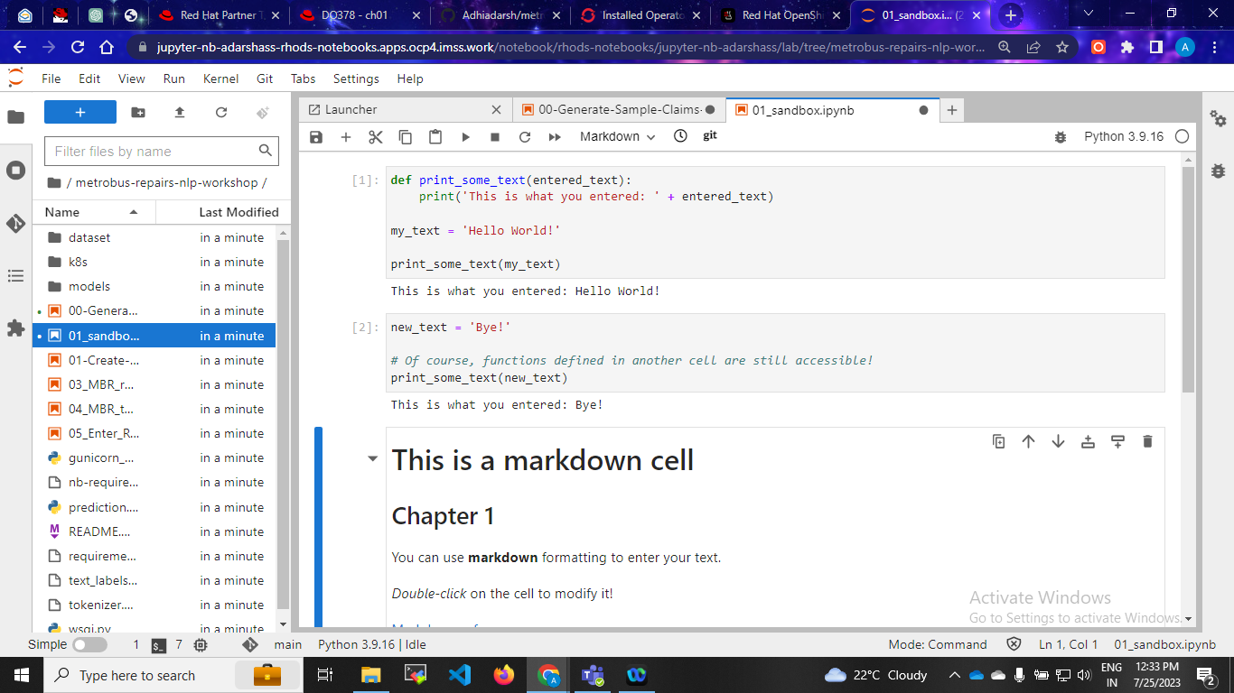
Step:7 Check this in jupyter

Slide 20
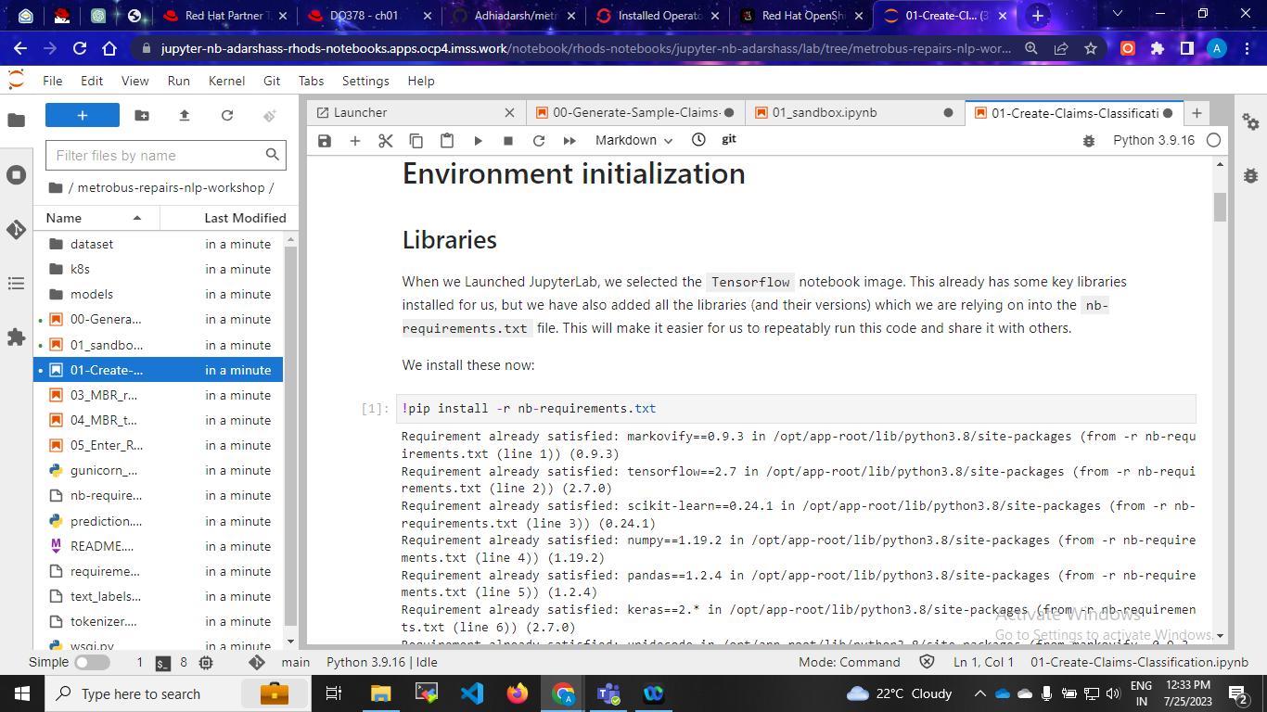
Downloading files

Slide 21
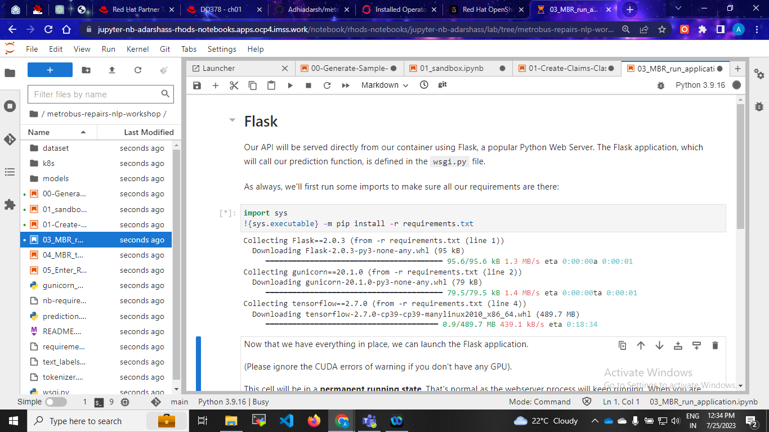
Step by step downloading

Slide 22
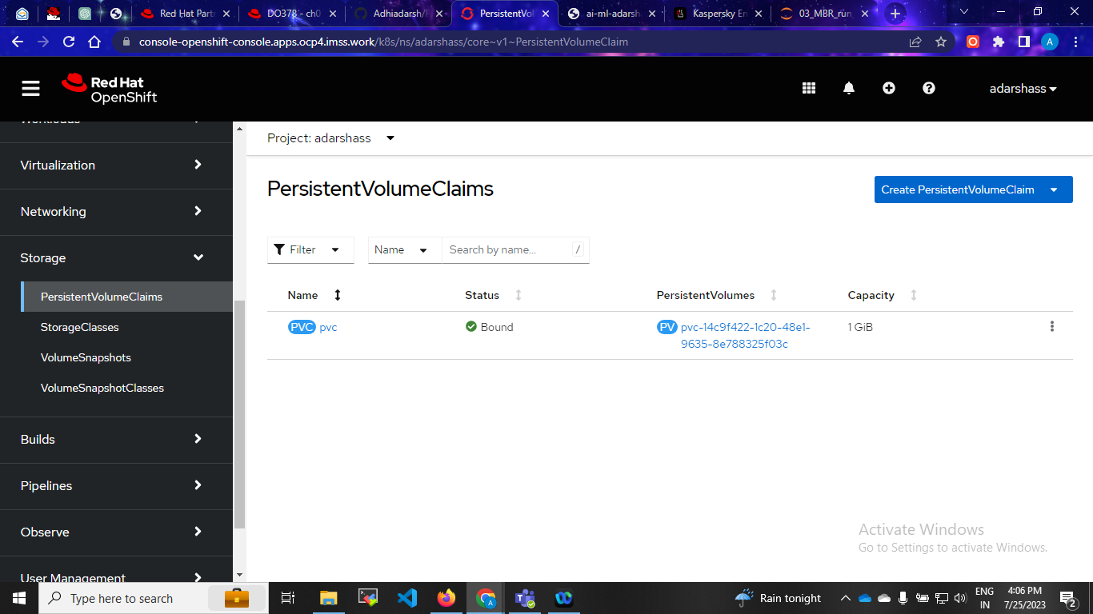
Create storage space(PVC)
Create new pvc

Slide 23
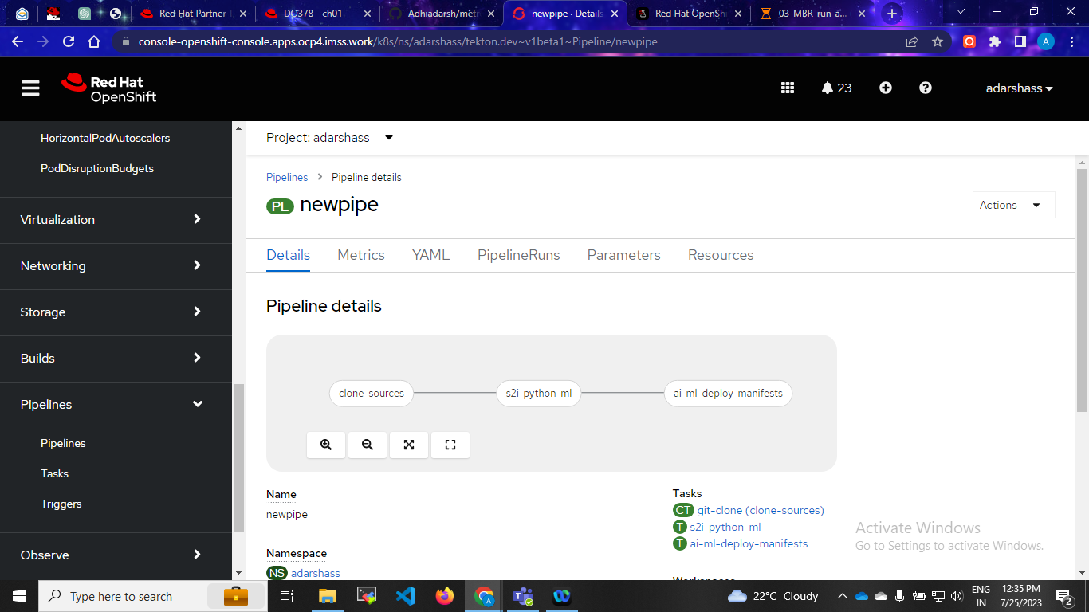
Step:8 Pipeline Deployment

Slide 24
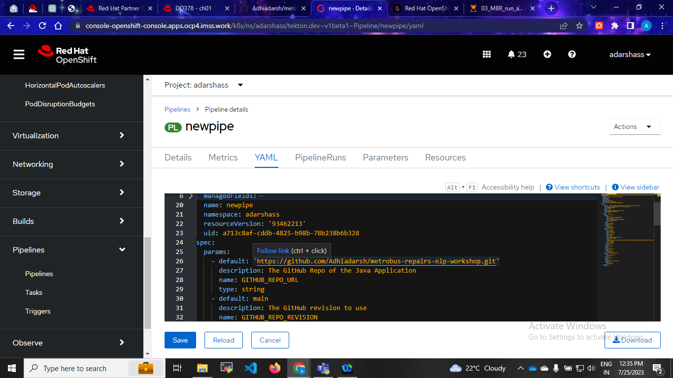
Pipeline yaml

Slide 25
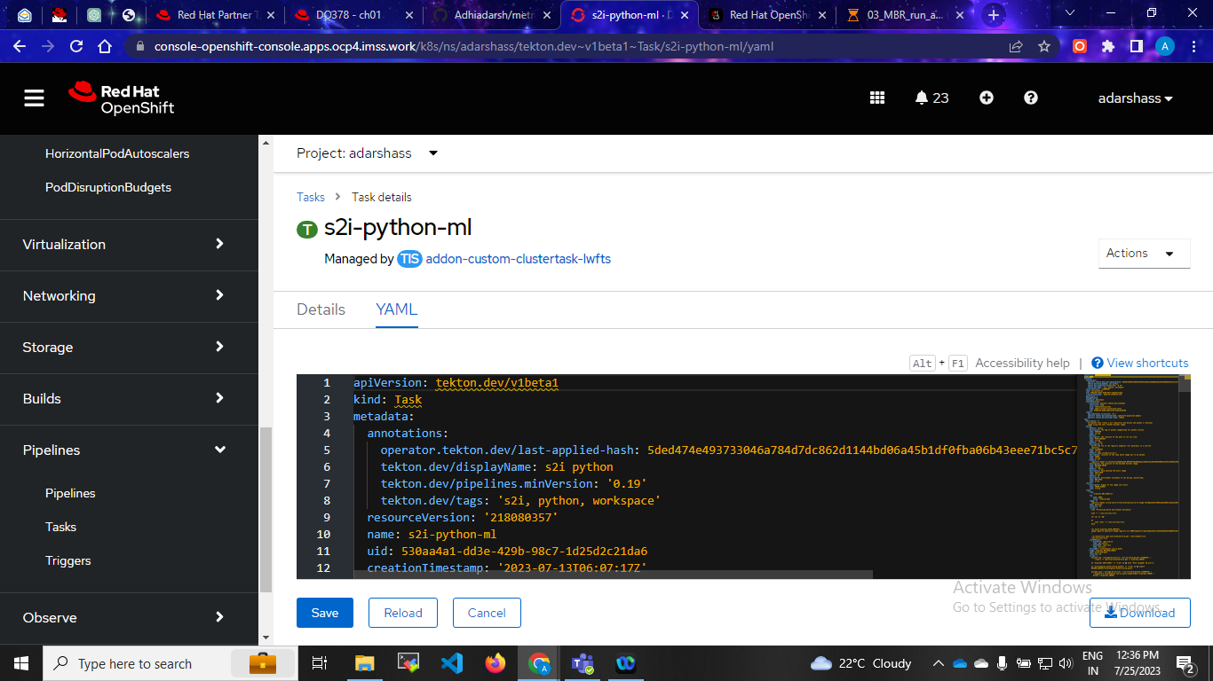
S2i task

Slide 26
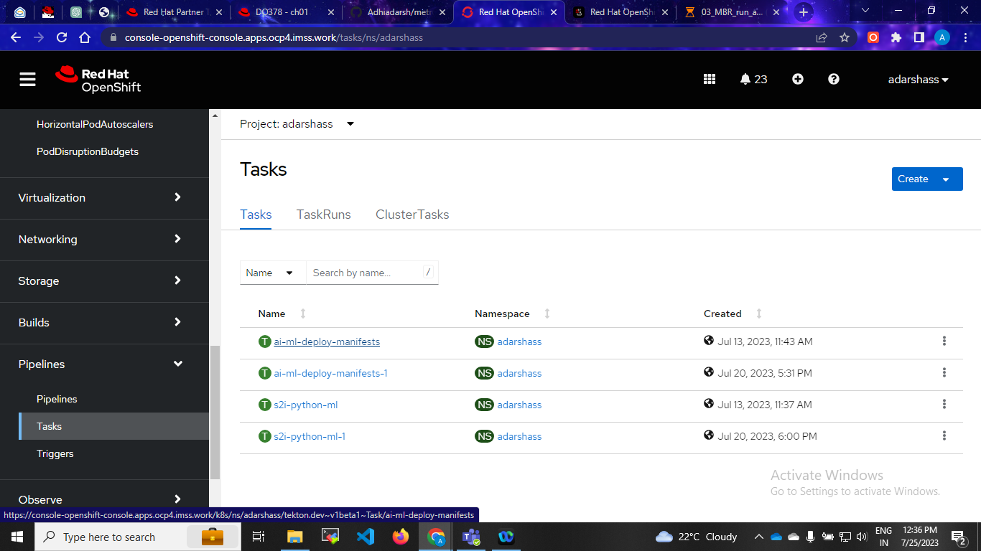
Step:9 Apply manifast file

Slide 27
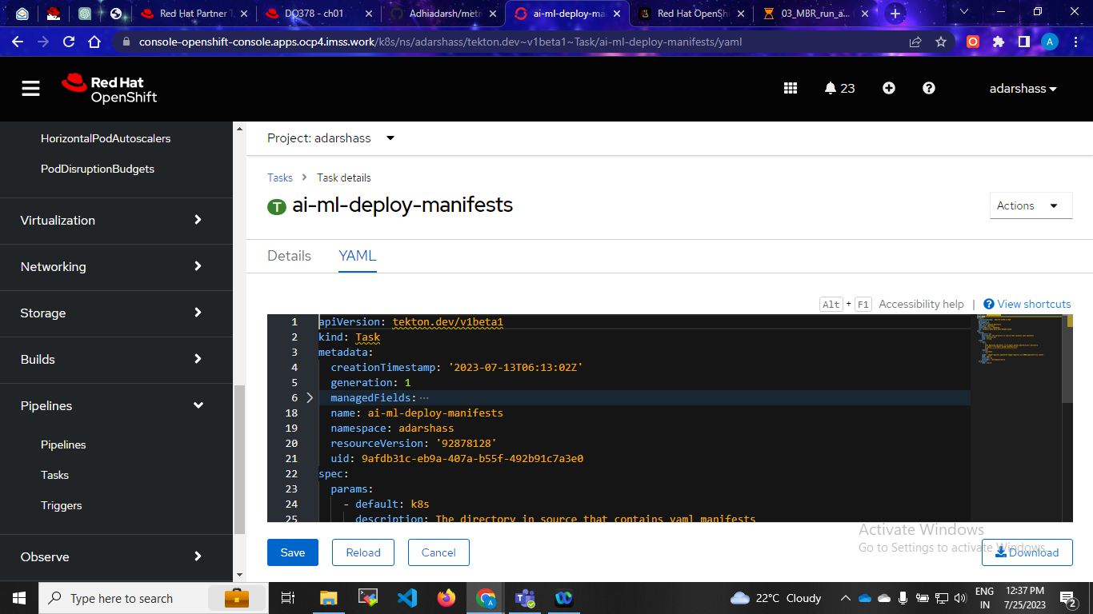
Apply yaml

Slide 28
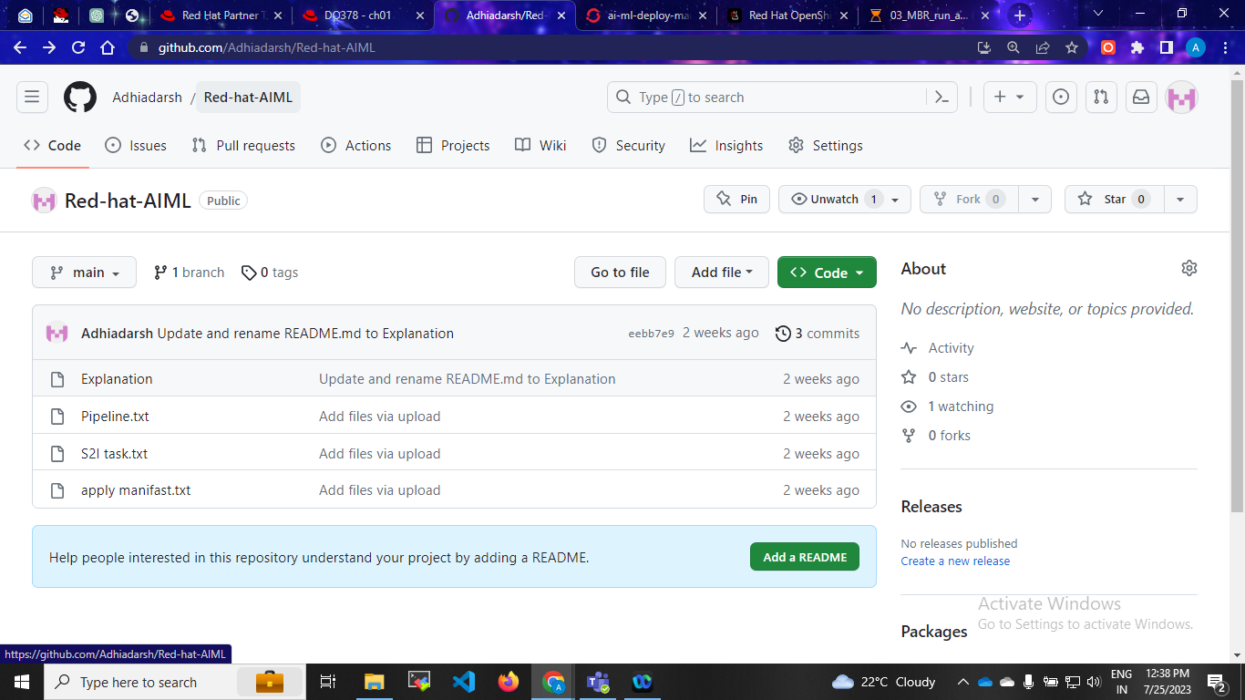
For task yaml files

Slide 29
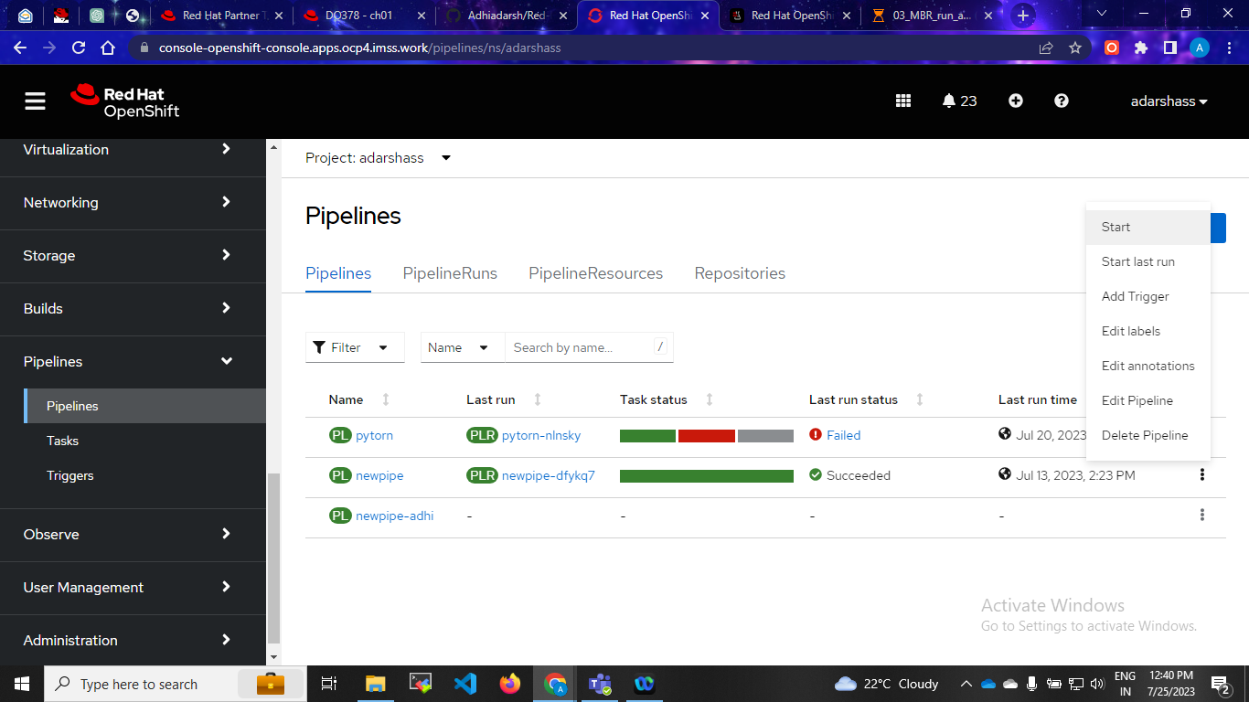
Succesfull pipeline

Slide 30
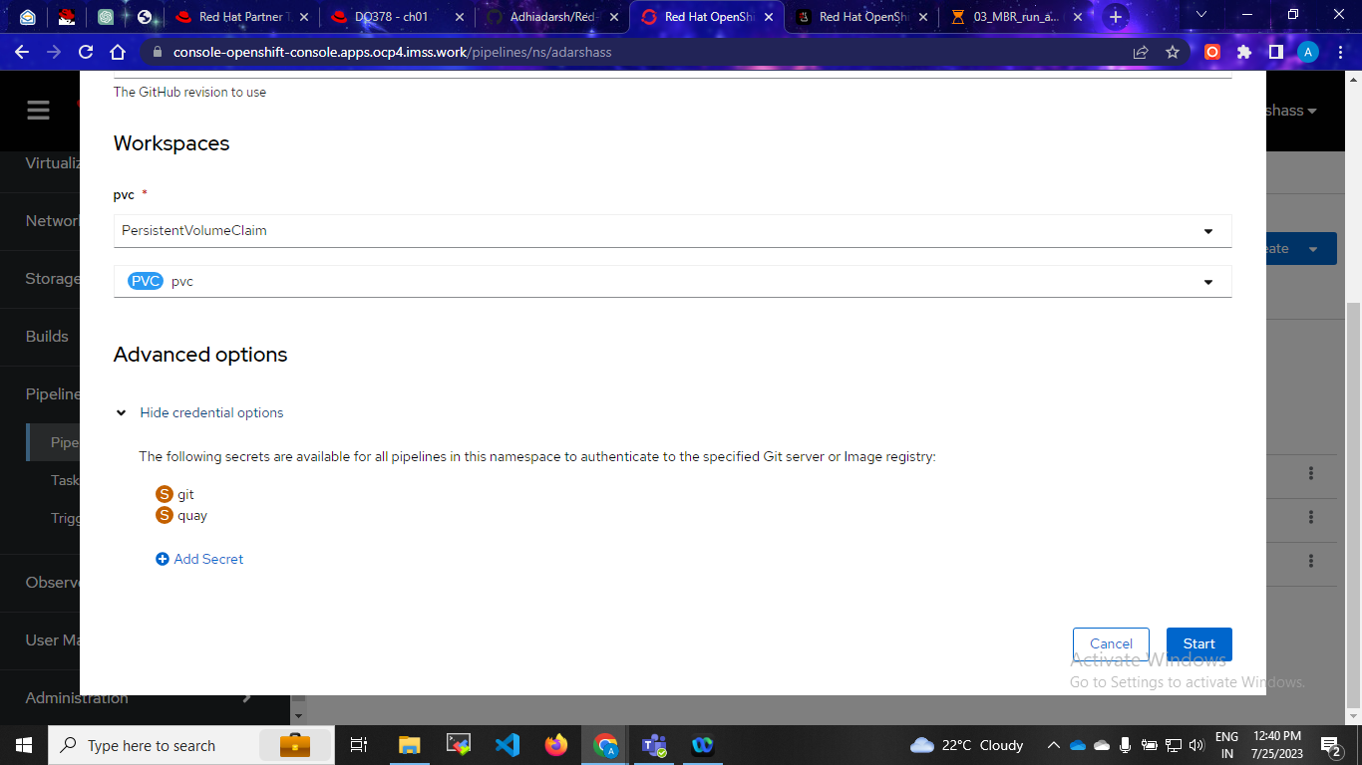
Step:10 Start pipeline important is secreat

Slide 31
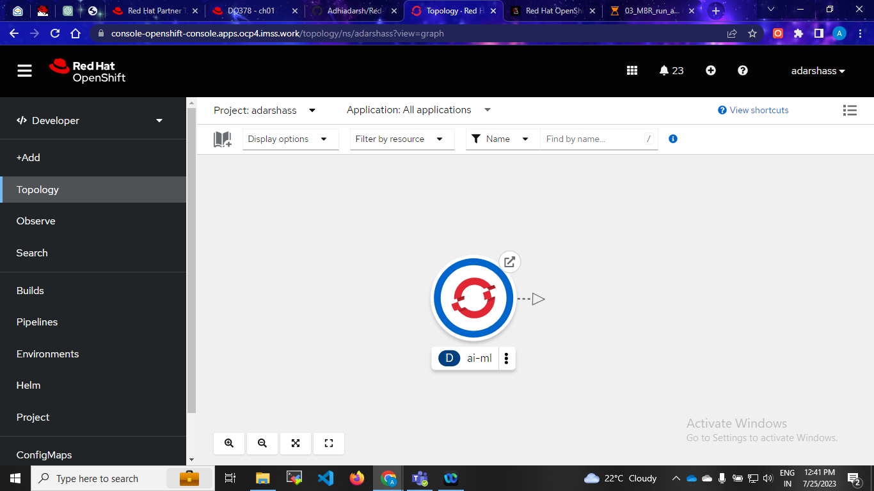
Succesfull running pod

Slide 32
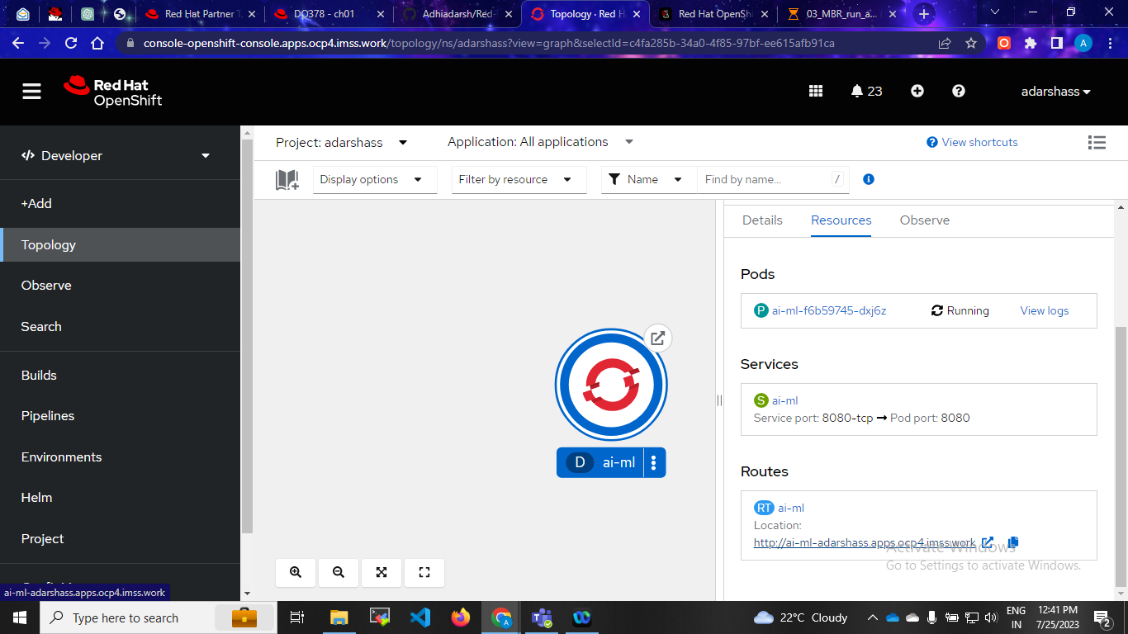
Click route url

Slide 33

Shows the final output

